Slide 1
Meet the Teacher
Darwin – Mr. bradley

Slide 2
Our School Rules:
Safe
Respectful
Ready
Our New School Values:
Ambition
Bravery
Kindness

Slide 3
Term 1 information
PE days – Monday and Friday
Reading at home expectation – at least four times a week
Timestables – weekly practise – square numbers this week
Further Homework will be set from term 2 – but please help the children learn their tables and number bonds to 100

Slide 4
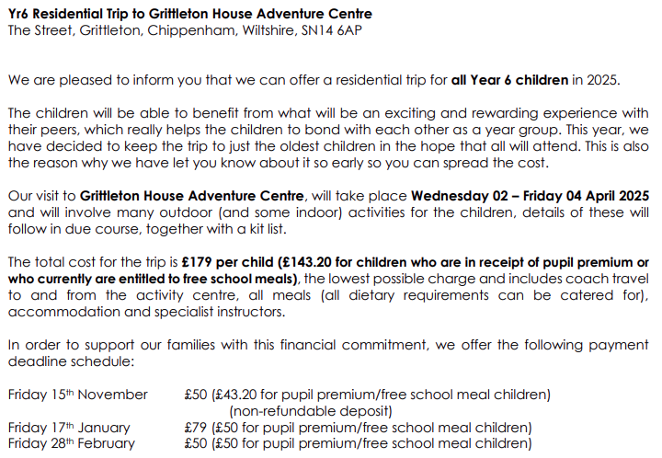
Grittleton

Slide 5





SATs
Key stage 2 tests
The statutory key stage 2 tests are timetabled from Monday 12 May to Thursday 15 May 2025.
Monday – Grammar and Spelling
Tuesday – Reading
Wednesday – Arithmetic and Reasoning 1
Thursday – Reasoning 2

Slide 6
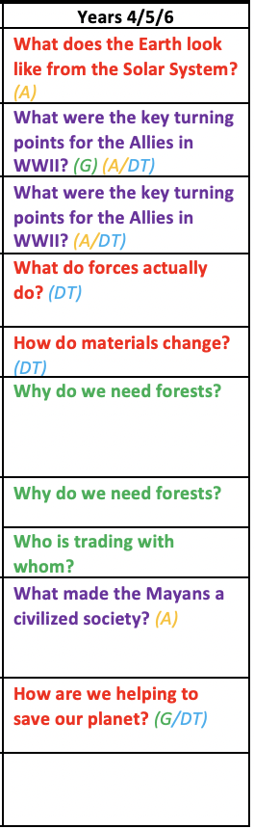
Learning Overview – Wider Curriculum
Terms 1 and 2 Terms 3 and 4 Terms 5 and 6

Slide 7
Any Questions?

